Slide 1




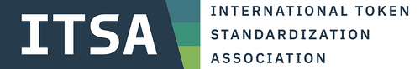




Session 2
ORGANIZED BY
Follow us on
February 7, 2024
Supported by

Slide 2
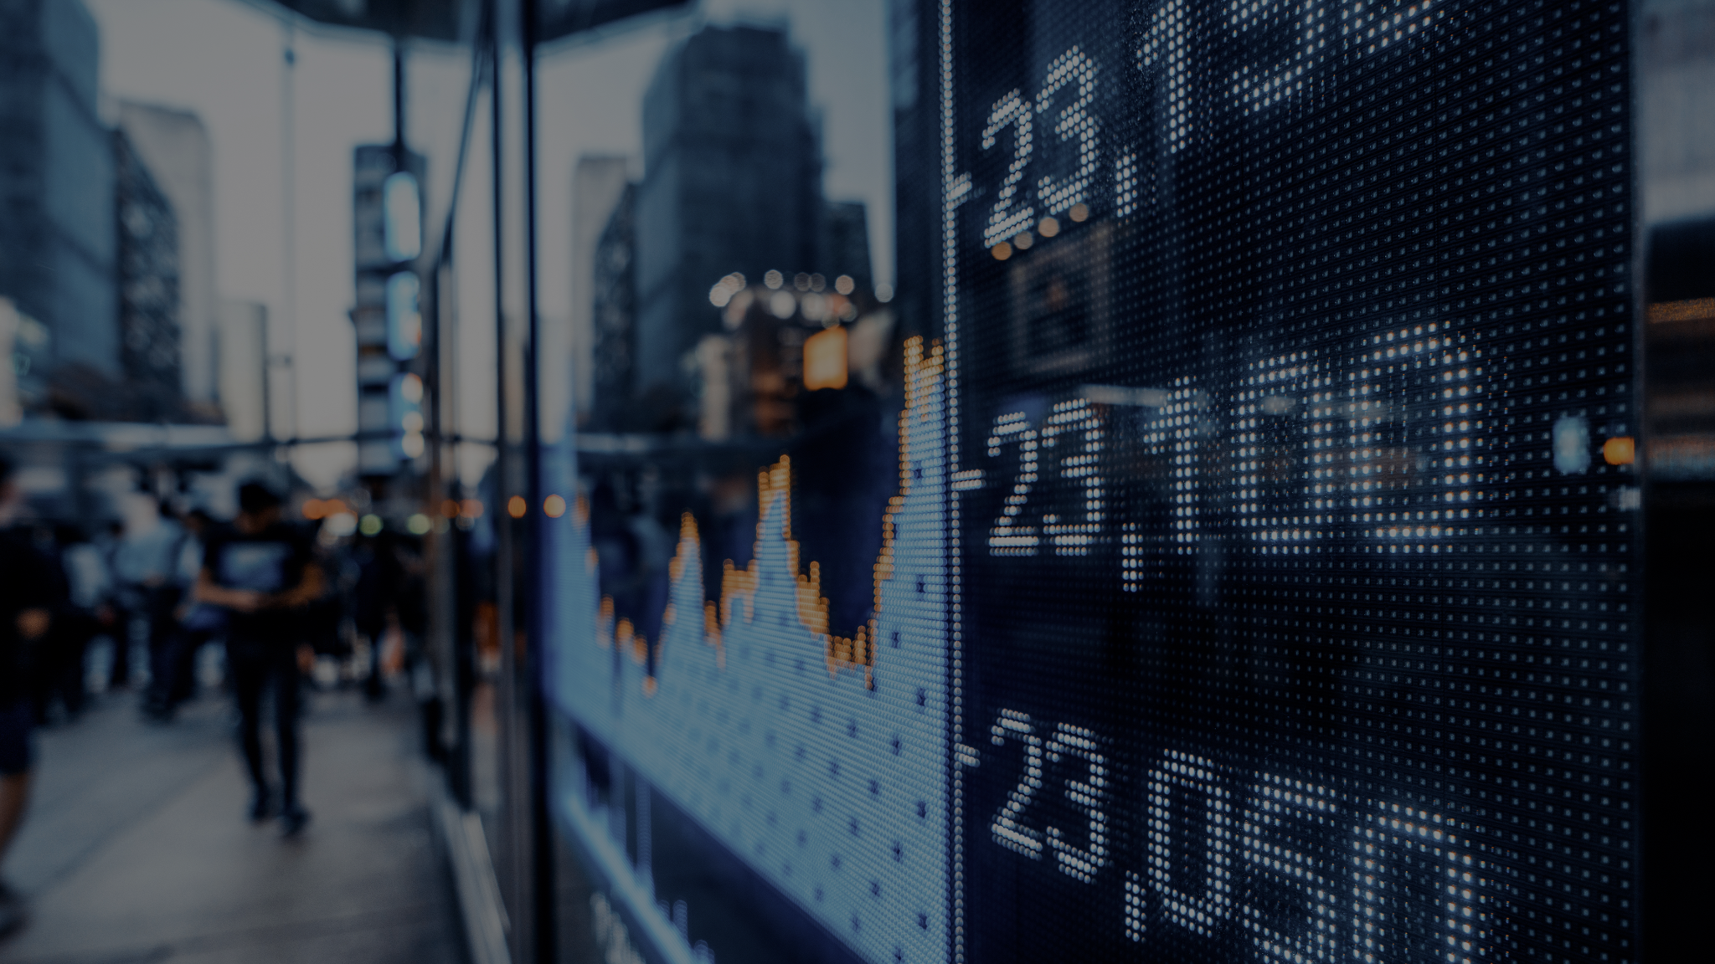
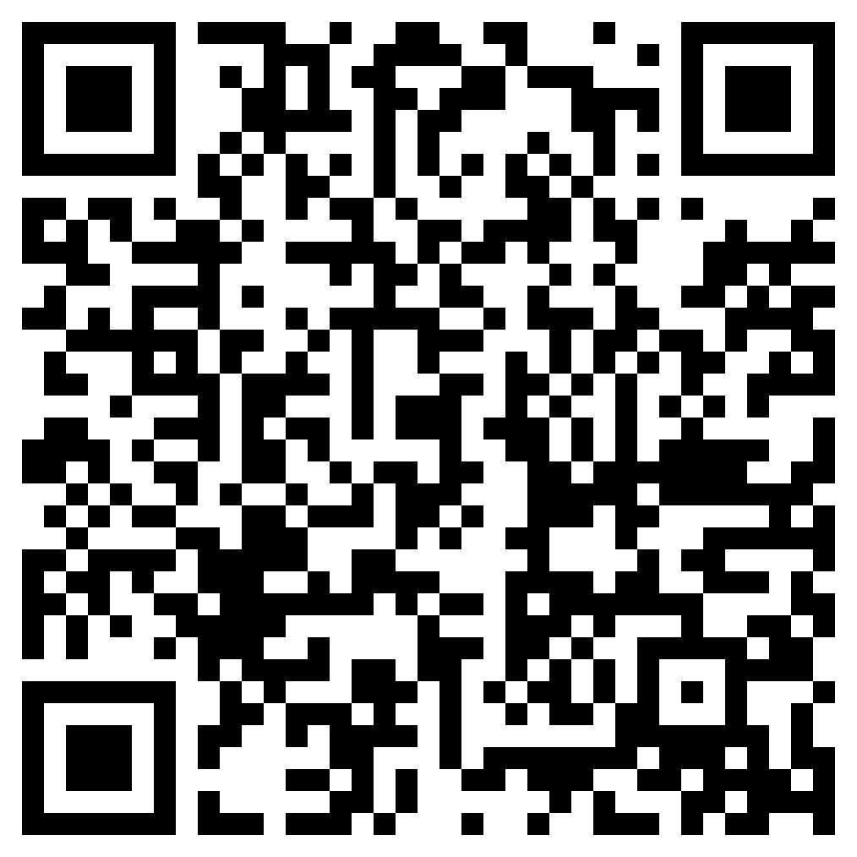


Seminarreihe zu Blockchain und Digitalisierung (🇩🇪)
Details & Registration
Starts
07
March 2024
Are you looking to take your digital assets journey to the next level? This seminar offers a deep dive into european regulation with leading experts in the fields of tokenization, legal, custody, and much more.
12 full in-person days at FS split across 4 blocks
Stand out as an expert in MiCAR & other applicable regulations
Connect with fellow industry leaders and executives
Web3 Talents Special Offer:
7,990 €
5,990 €

Slide 3
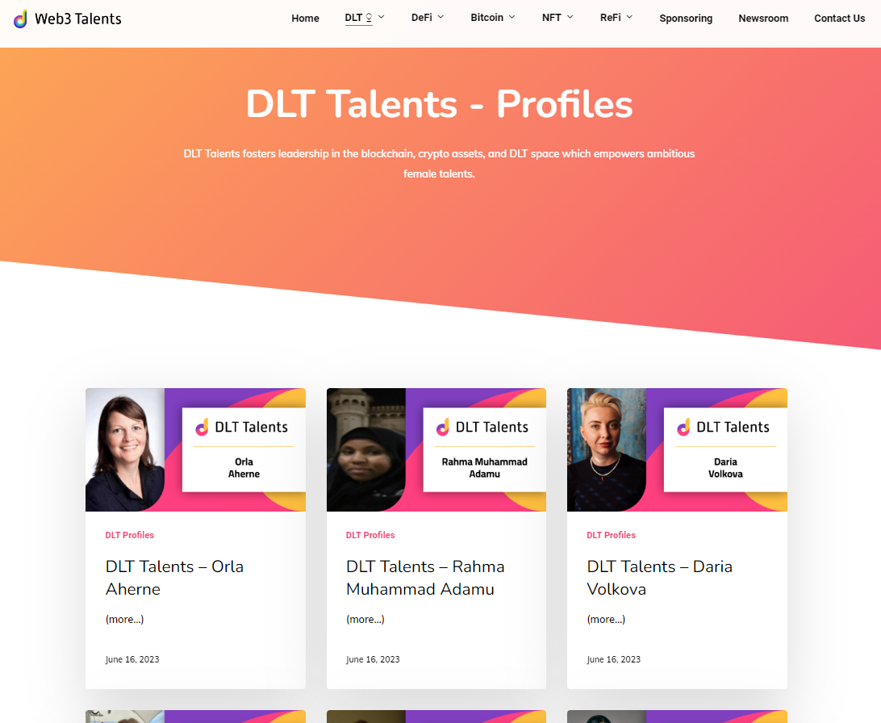
Organization
Session slides and other materials will be shared on Slack after each session and collected in the Bitcoin Talents / PUBLIC / Cohort 3 Google Drive folder (save this link).
Create a Profile Slide for yourself in order to be listed as a Talent on our Bitcoin Talents website (see https://web3-talents.io/dlt-talents/dlt-talents-profiles/) - Deadline: Friday, February 23, 2024
Notes:
Aptos: 130 000 transactions → ex Meta employees

Slide 4
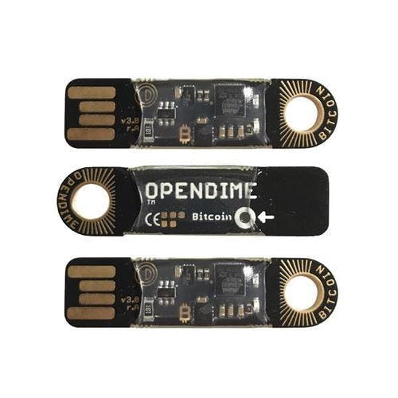
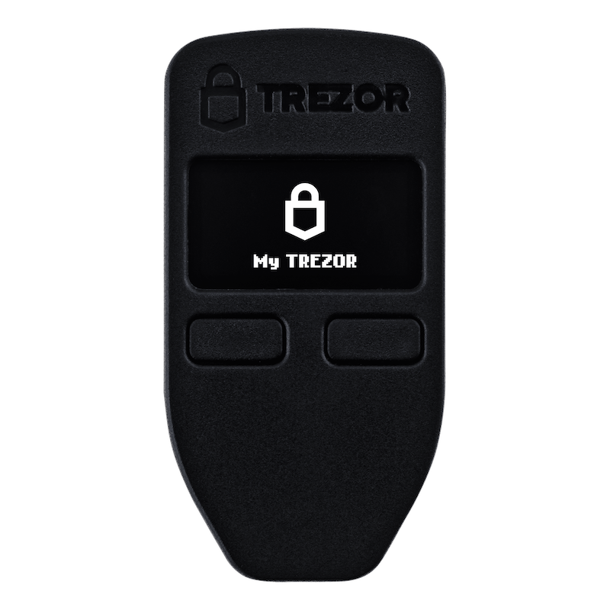
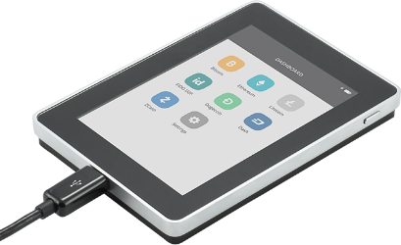
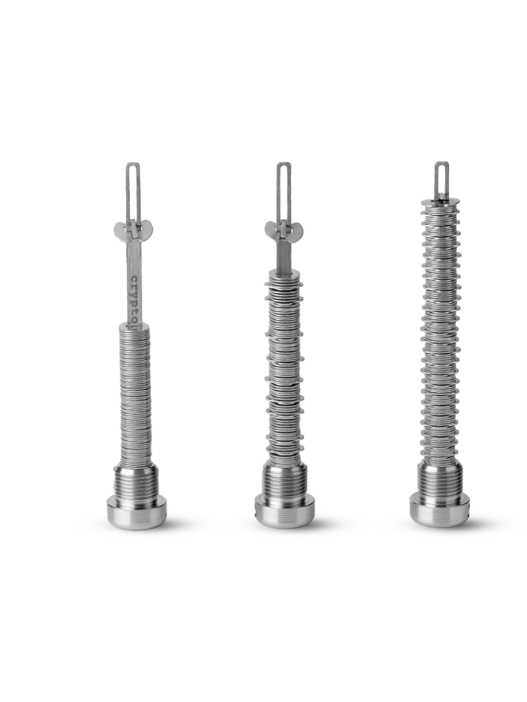
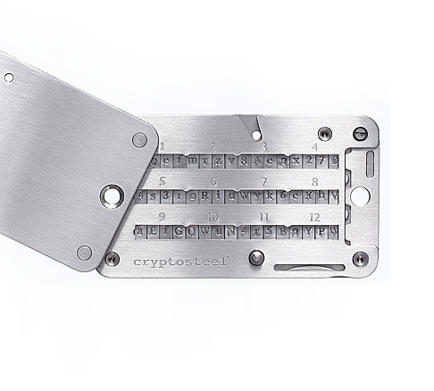
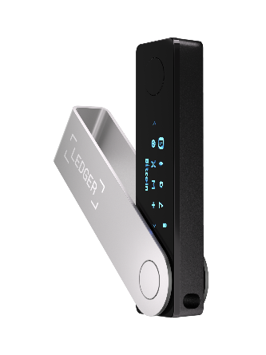
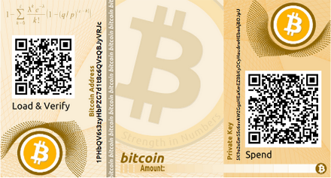
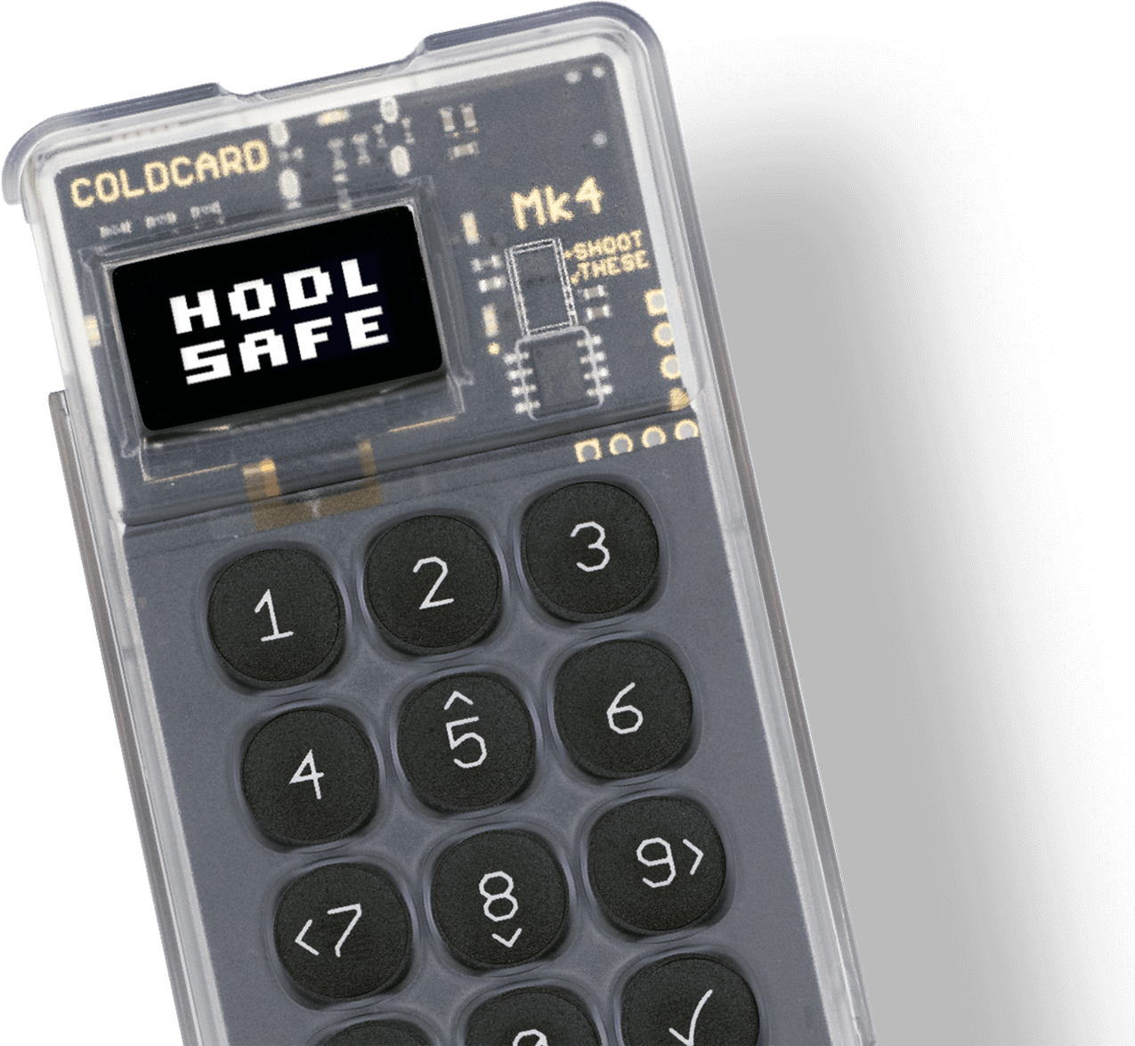
Tip of the week:
Not your Keys - Not your Coins!

Slide 5

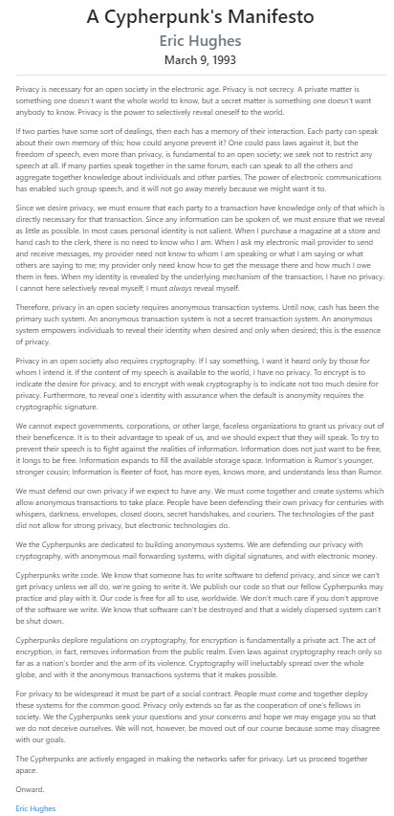
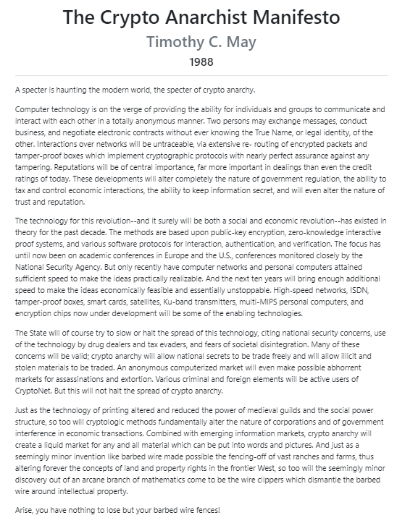
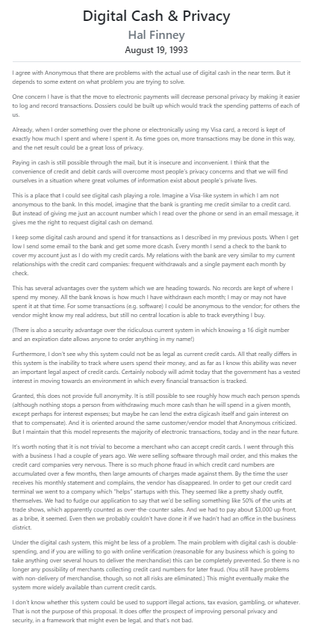
Stay informed
@Mentors: “Mentor - Name”
Notes:
Aptos: 130 000 transactions → ex Meta employees

Slide 6
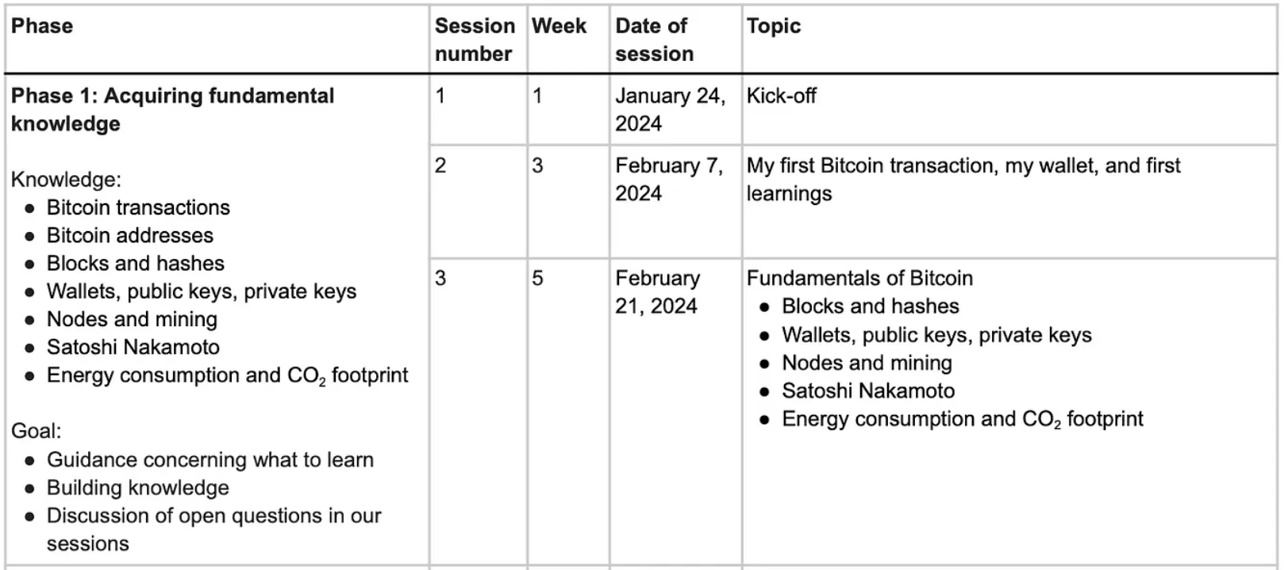
Outlook on the next session

Slide 7
Assignment 2
DYOR!
Update Profile Slide Information (Deadline: Friday, February 23, 2024, 12:00 PM [CET/CEST])
Bitcoin technical deep dive
Get a copy of “Mastering Bitcoin, 2nd Edition” by Andreas Antonopoulos for reference.
Free (non-.pdf version) at https://github.com/bitcoinbook/bitcoinbook. At least cursory read chapters 4 & 5.
Describe the steps to create a public (legacy) address, from private key to Base58 address type.
What other address types are there? Create a short description for each.
What is a HD wallet? What advantage does it have over non-deterministic wallets?
What information is contained in the Block header?
What is the current difficulty (Block 828904)? How many hashes does it take to mine a block?
Energy consumption and CO2 footprint
Research the current and historical power consumption of Bitcoin.
What are possible ways to reduce the CO2 footprint?
Practical: Connect with other Talents on Twitter, join the #twitter slack channel, follow the Bitcoin Talents Twitter list, participate in a Twitter Space. You can also introduce yourself to the whole cohort using THIS TABLE.
REMINDER: In order to participate in the program, you need to fill out this FORM. We need your confirmation on this form for GDPR reasons. Please note that you cannot participate in the program without filling out the survey.

Slide 8
Assignment XYZ
Add your text, images, screenshots, slides etc. here
Use this slide and add your content, text, image, screenshots etc. here. To do so, make a copy of this file for your own slides: Click on “File”, “Make a copy”, save the URL, then edit slides. Create more assignment slides when needed and change layout/design if desired.
Try to present your key learnings in less than 3 min.

Slide 9
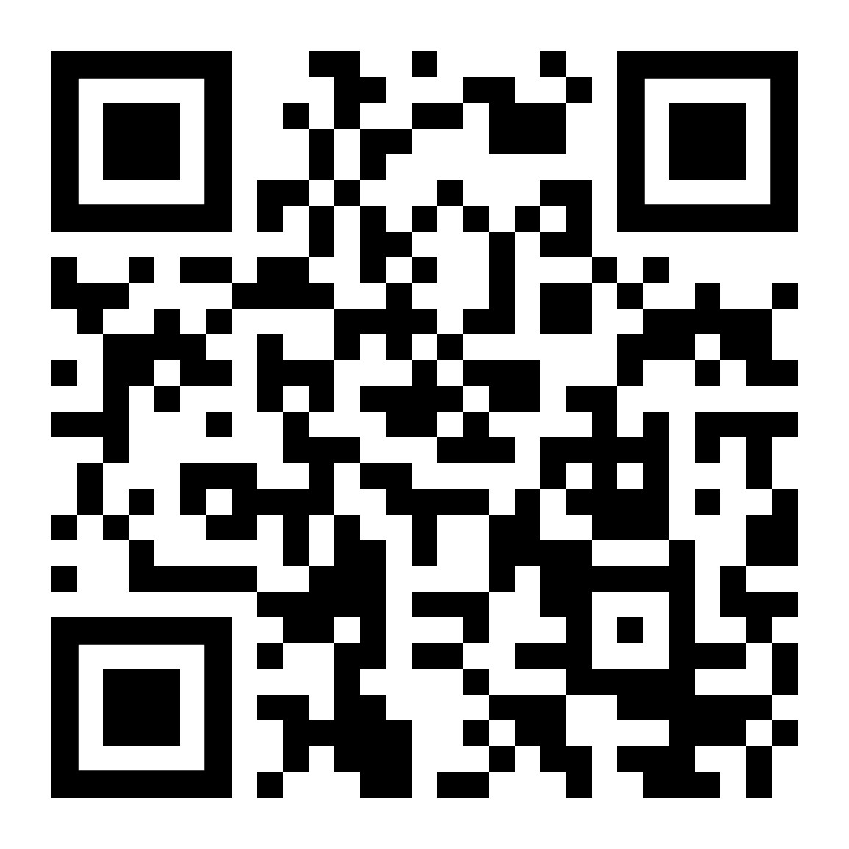
Submit Assignment
https://forms.gle/iRNjCf8TCHi8My7v5
You can use the Content Questionnaire to submit content, e.g., articles, studies, projects relevant to Bitcoin (needs to have relevant Bitcoin insights/content)

